Slide 1

Spectral Spacing Estimation and ICI Detection in Gridless WDM Systems Using Cumulant-Based Features and Machine Learning
Valentina Jaramillo
Julián Sánchez

Slide 2
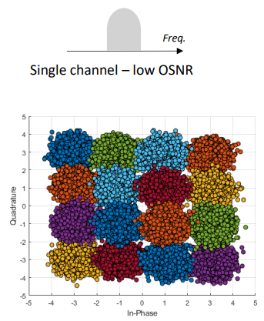
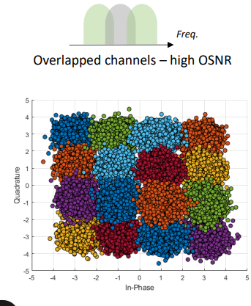

Introduction
The estimation and
mitigation of linear ICI
without adjacent-channel
information is challenging
because it behaves like
additive white Gaussian
noise (AWGN)

Slide 3
STATE OF THE ART
[1] A. Swami and B. M. Sadler, "Hierarchical Digital Modulation Classification Using Cumulants," IEEE Transactions on Communications, 2000.
[2] H. H. Khallaf, "Modulation Classification Using Higher Order Cumulants," IEEE MILCOM, 2005.
[3] Wenjie Sun, Shihang Lu, et al, “Efficient Recognition for MQAM Signal Using
Feature Extraction”

Slide 4
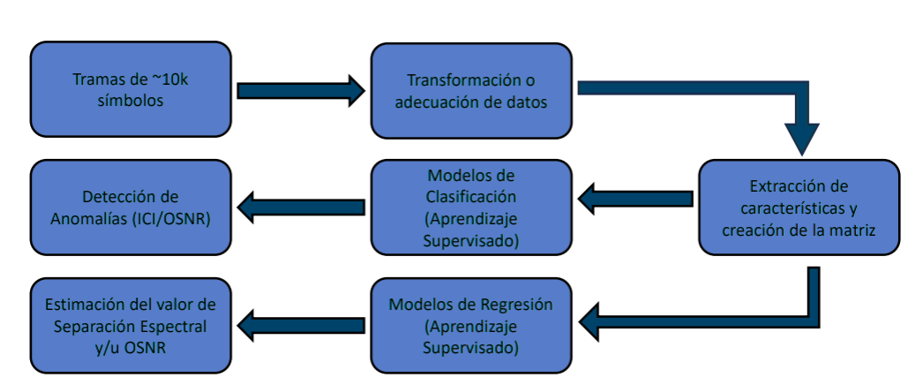
PROPOSAL

Slide 5
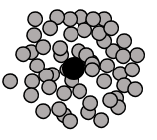
PROPOSAL-Featured Extraction
C20 – Second-order cumulant (variance / signal power)
C21 – Cross second-order cumulant (I–Q correlation)
C40 – Fourth-order cumulant (global kurtosis)
C41 – Cross fourth-order cumulant
C42 – Fourth-order cumulant (nonlinear I–Q dependence)

Slide 6
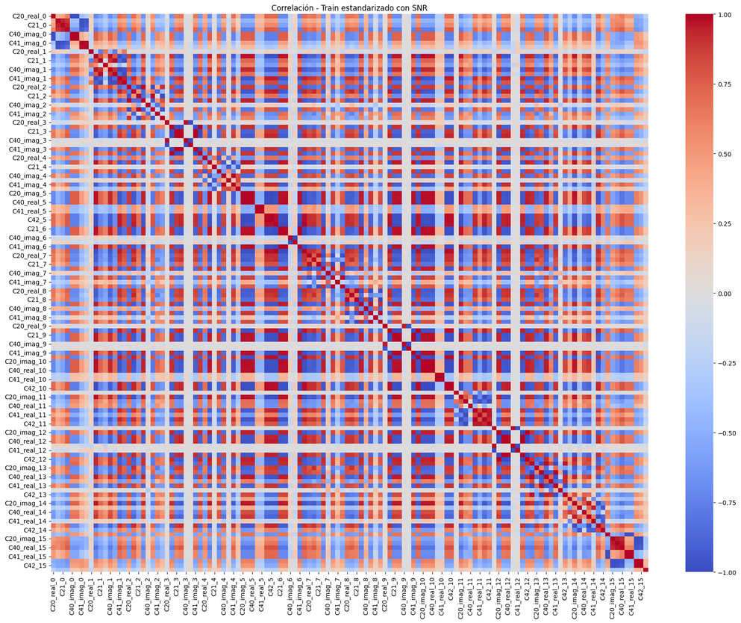
PROPOSAL- Correlation between features
  129 cumulant-based features per symbol were initially extracted.
  The resulting feature space contained high redundancy, strong multicollinearity, and several low-variance descriptors.
  Correlation matrices were computed (with and without including SNR) to analyze linear dependencies across features.
  Highly correlated feature pairs were identified using a |ρ| > 0.90 threshold.
  Redundant features were removed by eliminating one feature from each highly correlated pair, reducing dimensionality while preserving the most informative descriptors.

Slide 7
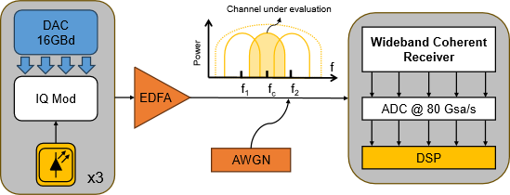
EXPERIMENTAL SCENARIO
  Three lasers with a linewidth of 100 kHz each
  3 × 16 GBd 16-QAM Nyquist-WDM system
  Dual-polarization IQ modulator
  Root-Raised-Cosine filter with a roll-off factor of 0.1
  Channel bandwidth (CBW) of 17.6 GHz
  B2B scenario

Slide 8
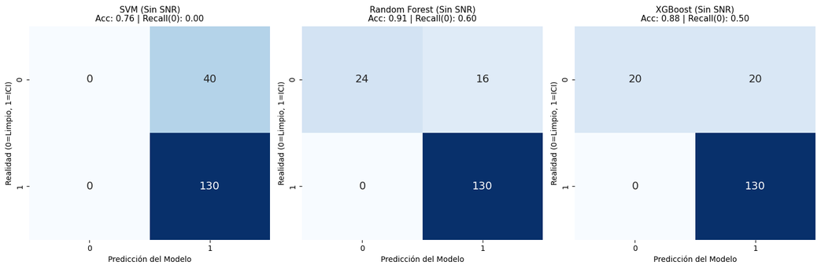
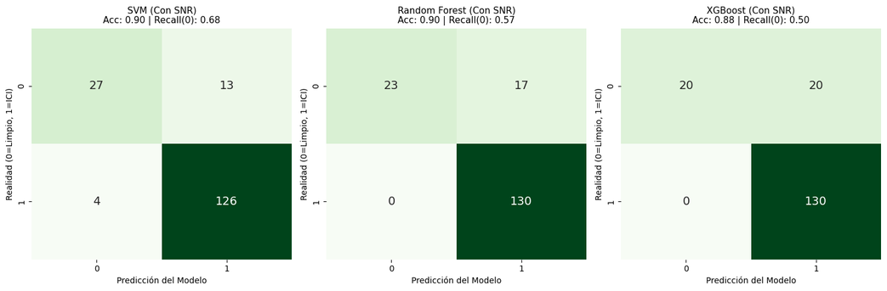
RESULTS - Classification (17.6 GHz = 1)

Slide 9
RESULTS - Classification comparation
Number of class | OSNR included in the classifier | Ch = 17.6 GHz Labeled as | Accuracy VGG16 Model [%] | [1] CNN techniques [%] | Proposal method SVM [%] | Proposal method XGBoost [%] | Proposal method Random Forest [%]
2 | Yes | Overlap | 86.3 | 93.15 | 0.90 | 0.88 | 0.90
 | Yes | No overlap | 60.27 | 91.78 | 0.70 | 0.71 | 0.78
 | No | Overlap | 86.30 | 91.78 | 0.76 | 0.88 | 0.90
 | No | No overlap | 61.64 | 90.41 | 0.68 | 0.7294 | 0.7235
[ 1] K. D. Martínez Zapata et al, “Estimation of spectral spacing and linear ICI effects using IQ constellation images and CNN in gridless WDM systems,” Univ. of Antioquia, GITA Lab, Medellín, Colombia, Jan. 2025

Slide 10
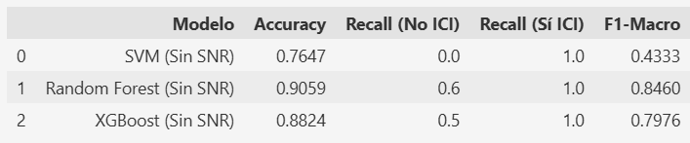
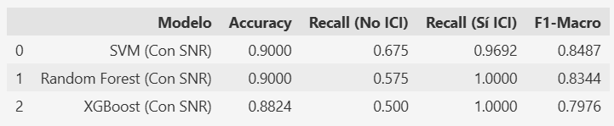
RESULTS - Classification Recall as a better metric
In this problem, accuracy does not reflect the true performance because the “ICI” class dominates and is easier to detect. A model can achieve high accuracy simply by predicting this class most of the time, even while failing completely on “No ICI.”
Class-wise recall—particularly Recall(No ICI)—is therefore a much more informative metric. F1-Macro also balances both classes and prevents the dominant class from hiding errors.
When SNR is added as a feature, class separability improves and recall increases, showing that recall is more sensitive to meaningful model improvements

Slide 11
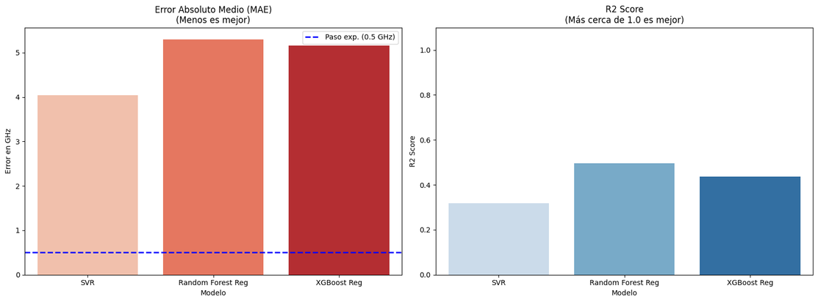
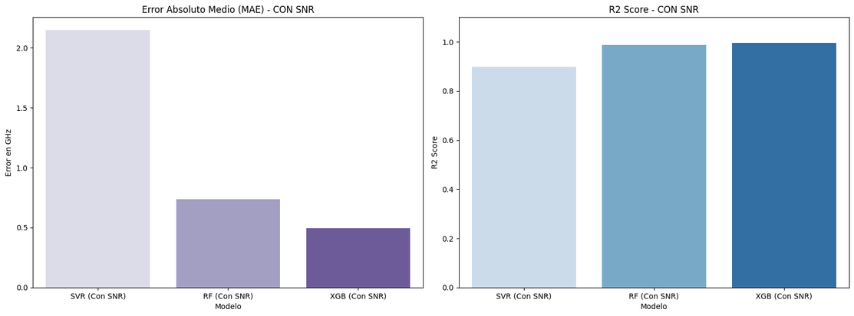
RESULTS - Regression (17.6 GHz = ‘1’)

Slide 12
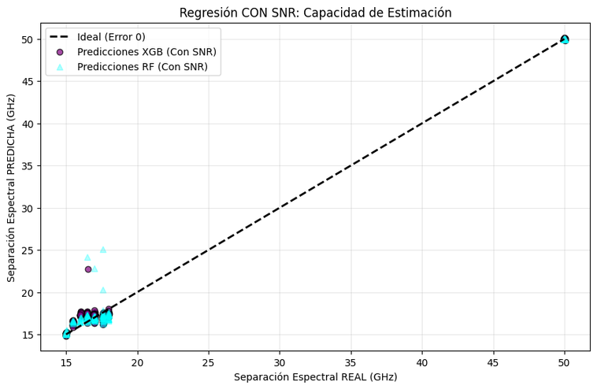
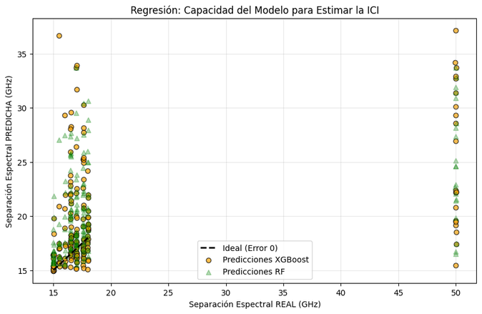
RESULTS - Regression
The regression results show that predicting the spectral separation is nearly impossible without SNR. All models exhibit low R² scores (< 0.20) and large errors (RMSE ≈ 10 GHz), which is reflected in the strong scatter of the predictions. This indicates that the available features do not contain sufficient information to estimate the bandwidth.
When SNR is included, the situation changes dramatically. Both Random Forest and XGBoost achieve nearly perfect performance (R² > 0.98 and RMSE < 1.2 GHz), and their predictions align closely with the ideal line. SNR provides a physically meaningful feature that is strongly correlated with spectral separation, enabling accurate regression.

Slide 13
CONCLUSIONS
  Despite the challenges of class imbalance, the proposed method is able to reliably distinguish between ICI and No-ICI. When the SNR feature is included, all models achieve perfect detection of ICI (Recall = 1.0), and the ability to identify No-ICI improves substantially—up to 0.675 in the SVM model. This confirms that the approach effectively captures the underlying patterns needed to discriminate both conditions.
  The inclusion of SNR not only improves classification but also leads to major gains in bandwidth estimation. Regression performance increases dramatically, with RMSE dropping from ~5 GHz to below 1 GHz in tree-based models, and R² rising from <0.20 to above 0.98. These improvements indicate that SNR provides essential information for accurately modeling ICI-related spectral behavior.
  Across both classification and regression tasks, models enhanced with SNR consistently outperform their counterparts without it. For instance, XGBoost achieves an R² of 0.9945 and MAE of only 0.53 GHz, demonstrating near-perfect bandwidth prediction. This consistency across methods confirms that the proposed pipeline is robust and generalizes well to ICI-related signal characterization.

Slide 14

Questions?
THANK YOU
  B.Sc. Valentina Restrepo Jaramillo
    valentina.restrepo@udea.edu.co
  B.Sc. Julián Mauricio Sánchez Ceballos
    julian.sanchez6@udea.edu.co
  Prof. Jhon James Granada
    jhon.granada@udea.edu.co

Slide 15
FUTURE WORK
  Extension to Larger and More Diverse Datasets
  Integration of Temporal and Frequency-Domain Features
  Real-Time Implementation and Evaluation in Hardware

Slide 16
BIBLIOGRAPHY
[1] C. A. Montoya Ocampo et al. , “Estimation of Spectral Spacing in Gridless Nyquist-WDM Systems Using Fuzzy Clustering and Deep Learning,” Universidad de Antioquia, GITA Lab, Medellín, Colombia, 2024
[2] W. Sun, et al. , “Efficient Recognition for MQAM Signal Using Feature Extraction,” School of Information and Communication Engineering, University of Electronic Science and Technology of China, Chengdu, China, 2024.
[3] K. D. Martínez Zapata et al, “Estimation of spectral spacing and linear ICI effects using IQ constellation images and CNN in gridless WDM systems,” Univ. of Antioquia, GITA Lab, Medell´ın, Colombia, Jan. 2025.

